Slide 1



Recent Review of the Judicial Map in Italy
Fabio Bartolomeo
Director general of statistics and organization analysis
Ministry of Justice - Italy
Rome – Zagreb, November 25th , 2016

Slide 2
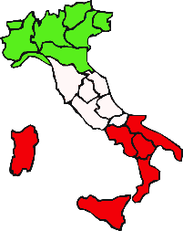
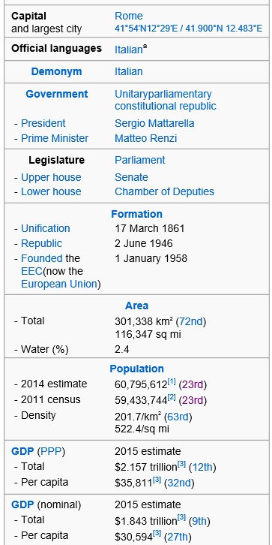
Italy’s judicial system one pager check-up
Performance
In comparison with other leading economies Italy’s judicial performance
is lower but:
after many years of growing pending cases the backlog of
civil proceedings is reducing at a significant pace;
clearance rate in civil sector was the highest in Europe (Cepej 2016);
length of proceedings started to go down in the civil sector;
performance indicators in the criminal sector are substantially stable
Human Resources
The law does not allow to hire new administrative staff, nevertheless:
new judges and prosecutors are hired through national competitive exam on a regular basis (almost yearly over the last 5y period)
the number of professionals judges is slightly growing, but still below the European median (Italy 11; Europe 17)
Although turnover is blocked, the MoJ is trying to reinforce the number of administrative staff by transferring people from other administrations. New hires are expected at the beginning of 2017
Workload
The number of incoming cases in the civil sector is decreasing very fast but it is not diminishing in the criminal field therefore the judicial system is continuously under a strong pressure
Key reforms launched with impact on performance and efficiency
Judicial map
Civil Mediation
Business Courts
Electronic Filing of Cases (PCT)
Assisted negotiation and Arbitration
Datawarehouse and Strasburg Program

Slide 3
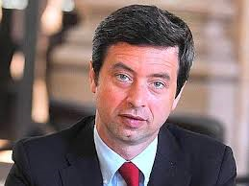
Ministry of Justice and High Council (CSM)
Key responsibilities of the Ministry of Justice
Key responsibilities of the High Council
Courts management
Performance monitoring
Administrative staff
Administrative tasks related to both civil and criminal justice
Prisons and probation services
Training of judges (in cooperation with High Council)
Guarantee the independence of the judiciary
Hiring of judges and prosecutors
Career and transfer of judges and prosecutors
Disciplinary process
Training of judges (in cooperation with MoJ)
Minister of Justice
Andrea Orlando

Slide 4
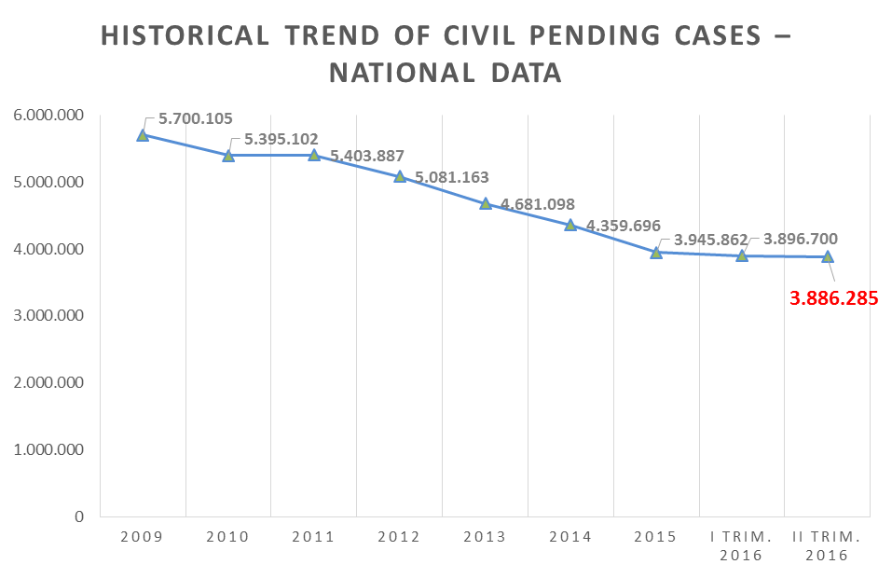
A long-trend path of backlog reduction
Historical data on pending civil cases shows a downward trend: from almost 6M at the end of 2009 to less than 4M as af 30 June 2016, civil justice has shown significant improvement over the past few years

Slide 5




Judicial system performance is improving but it is still below international benchmarks
From 147° on DB15 +36 position in one year!

Slide 6
Our 27 best-in-class tribunals perform in line with leading economies so the key problem is to extend the best practices into the while country
Average disposal time of civil cases
96
«poor performers»
965
Italia
16
«medium class»
663
27
«best in class»
490
Average (ww)
636*
Benchmark World Bank
Svizzera
390
Germania
429
Francia
395
(*) not a proper statistical average
6

Slide 7
The judicial map review in italy of 2013

Slide 8
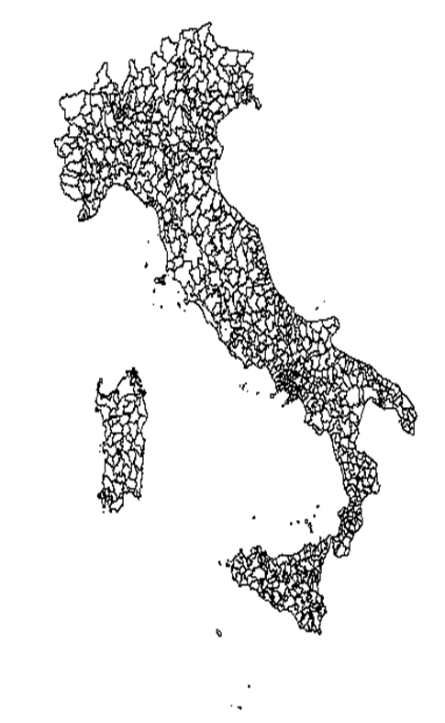
Where did we start from…
Previous judicial map had no significant changes since the Italian State unification, back in 1861. The logic along the history was primarily that to introduce new offices and branches without an organic plan.
Too fragmented and inconsistent judicial map: a total of more than 2.000 offices, one of the highest number in Europe in terms of both, absolute value and population per-capita indicators.
63 tribunals had less than 15 judges each, creating serious problems to office productivity, even in cases of few vacancies and leaves of absence (e.g. 3 judges missing in such offices would mean
-20% in headcount).
Italy had 220 offices (sezioni distaccate) with an average of 2,5 judges each.
55 smallest tribunals (one third of the total 165) served only 10% of Italian population.

Slide 9

… and what is the global context in which we are living today
We live in times of permanent and profound changes. The creation of new infrastructures makes certain places more accessible than in the past; the development of modern means of transport makes it faster and easier to travel; technology has changed the way we work and the modes of interaction between individuals, businesses and the
public administration
Global economic crisis is forcing production processes, whether private or public, aimed at the rationalisation of assets, at the reduction of costs and at the increase of efficiency
The administration of justice is part of this context,
as a consequence, it is in the process of reviewing its organisation in a way to optimise asset allocation and increase efficiency without losing attention to the quality of both the service provided and the judgments

Slide 10

Drawing judicial maps and the trade-off
between Access, Efficiency and Quality of Justice
The objective of the Italian reform was to reach an equilibrium between different factors:
Access to justice in terms of proximity of courts to citizens
Optimum size of a court so that the presence of various competences and functions can be ensured
Reduction of costs as the resources of the public administration cannot and must not be wasted but rather optimised
Maximisation of quality and adequate performance of the service provided
Access
Cost/Efficiency
Quality/Performance

Slide 11
Judicial map reform: a phased approach (… not an administrative task)
ASSESS CURRENT JUDICIAL MAP AND INDICATORS
SET OBJECTIVES AND CRITERIA
BUILD AND MEASURE INDICATORS
DEFINE NEW JUDICIAL MAP
List of factors that were considered into the Italian reform:
Additional factors that could be considered when reviewing a judicial map:
Population Density
Performance indicators
Size of Court
Geographical Location
Infrastructure
Computerization
Court Facilities (telephone/video)
Level of Business
ADR/Mediation
Cultural Sophistication
Availability of Legal Advice
Recruitment of Staff

Slide 12

Assess current judicial map
ASSESS CURRENT JUDICIAL MAP AND INDICATORS
The availability of data and information plays a major role
Policy makers need to know their judicial systems in every detail before defining objectives and criteria for conducting such reform
Italian ministry of justice has collected data from internal and external sources:
  judicial administration data such as incoming, completed and pending cases including all inherent sub-classifications and distribution shall be retrieved from ministries of justice and other court administration authorities;
  performance indicators like offices’ and judges’ productivity, proceedings disposal times can be provided by statistics departments within judicial systems or even collected by the courts themselves;
  geographic, transportation and infrastructure data can be taken from specialised authorities or rather found on reliable sites on the web;
  any other specific information such as the level of business, number of enterprises, legal assistance etc. can be retrieved by associations of professionals and again from reliable websites.

Slide 13

Always begin with the end in mind
SET OBJECTIVES AND CRITERIA
Reduce cost
Improve performance
Favorite specialization
Increase efficiency
Optimize geography and access to justice

Slide 14
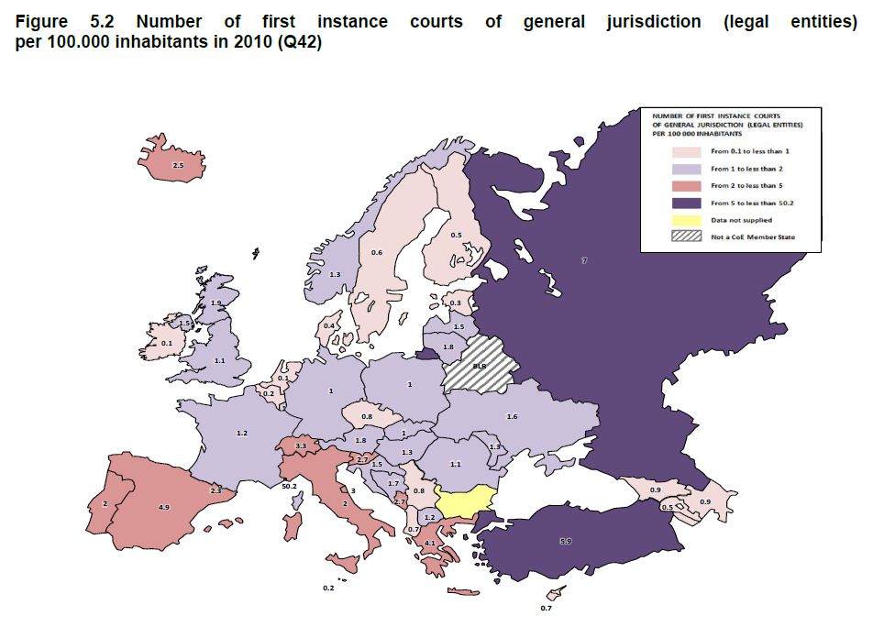
BUILD AND MEASURE INDICATORS
Population density
Population served should be normalized considering also distances and litigation ratio of the given territory.
Source: European judicial systems, Cepej 2012
Average number of people served by a first instance court = 25.599*
Avg nr of people served by first inst. court considering each state average as an entry = 159.000*
(*) The 42 countries who provided this information were considered

Slide 15
BUILD AND MEASURE INDICATORS
Courts’ geographical location
Must all services provided within a court remain within the main court?
Do we need the full physical presence
of a court, even if what most
customers need to do
is to collect a form
or simply file some
documentation to
start their
proceedings?
City A
City D
City B
City C
Minimizing traveling time
From / to in minutes | City A | City B | City C | City D
City A | 0 | 30 min | 35 min | 60 min
City B | 30 min | 0 | 20 min | 35 min
City C | 35 min | 20 min | 0 | 20 min
City D | 60 min | 35 min | 20 min | 0
Totals | 125 min | 85 min | 75 min | 115 min

Slide 16
BUILD AND MEASURE INDICATORS
Size of a court – the Italian case
Reduced fragmentation while maintaining adequate level of access to justice (we have still more than one tribunal per city - capoluogo)
Reduced variance in workload: the smallest tribunal under the old geography (Mistretta) managed around 1.500 cases per year, the smallest one under the new judicial map (Lanusei) manages around 3.200 cases per year
Increased number of judges per office are expected to give the following advantages:
  Enhanced specialization
  Improved creation and efficiency
  of “collegiums”
  Increased productivity
ILLUSTRATIVE
(Italy)
Productivity
STUDY OF CORRELATION BETWEEN SIZE AND PRODUCTIVITY OF COURTS
Size (number of judges)

Slide 17
Key reference indicators – the Italian case
Reference Indicators
 | TOTALE ITALIA | VALORI MEDI ITALIA | VALORI MEDI CIRCONDARI PROVINCIALI (ESCLUSI METROPOLITANI) | VALORI MEDI CIRCONDARI NON PROVINCIALI
Distretto | 29 (26+3 sez.dis.) | N/A | N/A | N/A
Circondario | 165 | N/A | N/A | N/A
Popolazione (2011) | 59.464.644 | 360.392 | 382.191 | 181.676
Magistrati | 5.063 | 31 | 28 | 15
Amministrativi | 16.437 | 100 | 95 | 52
Rapporto di composizione (Amministrativi/Magistrati) | N/A | 3,2 | 3,4 | 3,4
Totale sopravvenuti | 3.072.810 | 18.623 | 18.094 | 8.806
Carico di lavoro unitario (sopravvenuti/Magistrati) | N/A | 606,9 | 647,1 | 574,3
Totale definiti | 3.040.855 | 18.429 | 17.851 | 8.675
Produttività (definiti/Magistrati) | N/A | 600,6 | 638,4 | 565,8
2
4
1
3

Slide 18
BUILD AND MEASURE INDICATORS
Performance stats and other useful/available structure indicators [1/2]

Slide 19
BUILD AND MEASURE INDICATORS
Performance stats and other useful/available structure indicators [2/2]

Slide 20



Implementing the judicial map
DEFINE NEW JUDICIAL MAP
Transition
People Transfer
Measure results

Slide 21

DEFINE NEW JUDICIAL MAP
Use of indicators in concrete
As perfectly summarized by the Sciences Po Strasbourg Consulting in their “Comparative study of the reforms of the judicial maps in Europe (2012)” each country used a variety of criteria to ensure the most pragmatic appreciation of each court situation, but there is no denying that in fact the activity level of the jurisdictions prevailed, even though it was, nonetheless, toned down by other considerations such as geographical/temporal distance or the necessity for justice to be present in some areas.
Nevertheless, the general trend is that courts with the fewest judges dealing with the lowest numbers of cases are targeted and closed down during judicial map reforms. However, whatever the number of indicators selected, the question for reformers is how to assemble them in order to come up with the list of offices to be eventually closed down.

Slide 22
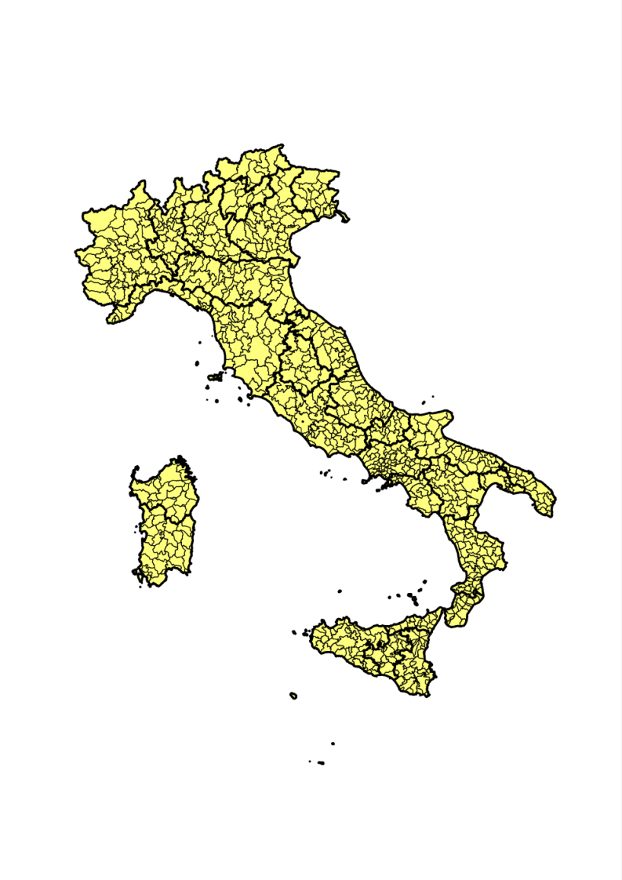
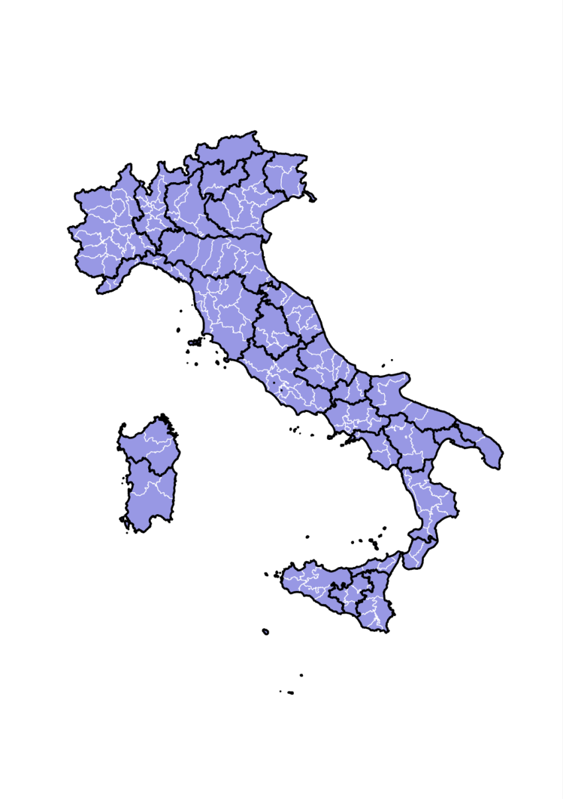

Final result of the judicial map review in Italy, done in 2013
DEFINE NEW JUDICIAL MAP
As it was
As it is
From 1.396 offices (in the scope of the law) down to apx 650, i.e. closing about 750 offices
Judges of the peace
From 846 to apx. 380*
«Sezioni distaccate»
From 220 to 0
Tribunals & ProsecutorOffices
From 165 to 135
(*) Procedure is currently ongoing

Slide 23

How to measure results

Slide 24
Judicial system indicators and performance indicators
Key judicial system indicators (structure and organization)
Economics: GDP, cost of justice, court administration vs prison system, civil sector vs criminal, per-capita indicators, etc.
Access to justice and organization: legal aid, court fees, judicial maps, courts and people served
Use of Information and Communication Technology (ICT): level of use, type of IT systems used, performance measuring, e-justice, videoconferencing
Personnel: judges, prosecutors, staff, training, career, rewarding
Other indicators: ADR, lawyers, notary, translators.
KPIs (judicial systems performance)
Flows: Incoming, Resolved and Pending cases
Clearance rate: Resolved cases / Incoming cases (in a period)
Disposal time Pending cases / Resolved cases (in a period)
Judges/Court productivity Number of cases resolved by judge/court (in a period)

Slide 25

Conducting satisfaction surveys of court users
As mentioned before, quality is ultimately related to the judgment and perception of the final users of the justice service.
That’s why the Council of Europe is promoting the conduction of surveys among users with the objective to:
evaluate the satisfaction level of Justice amongst the final users
identify performance indicators to be tracked throughout time
pinpoint areas of improvement and (propose to) take action accordingly
analyze the satisfaction amongst specific sub-samples or categories (e.g. males/ females, age classes, lawyers, clerks…)
How satisfied or dissatisfied are you with your personal experience of the court today?

Slide 26
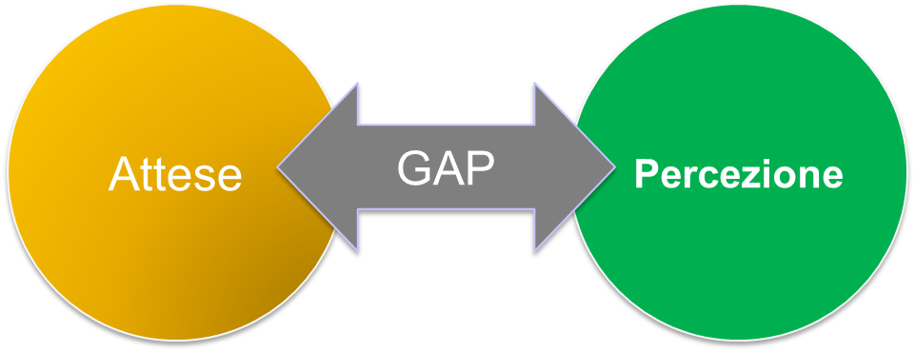
Methodology and target for the surveys
The SERVQUAL methodology is based on the concept of measuring the gap between the expectations (what the users expect to receive from that service) and perceptions (what effectively the users get from that service when utilized) of the users.
Expectations
Perceptions
The target has been defined according to the following criteria:
External users
Internal users
Parties
Witnesses
Interpreters, experts
Relatives of the Parties, of witnesses, etc.
Lawyers
Judges, Prosecutors and staff of the Court
Policemen, Bailiffs, etc.

Slide 27
The Vietti’s commission report (about the judicial map)
Optimize second instance courts: in Italy there are 26 courts of appeal plus 3 “secondary” sites. The current organization in terms of people served, cases treated and territorial competence is not homogeneous. The two proposals are:
  To rationalize the organization in terms of people, workloads and territorial competence
  To reduce their number by “cutting” courts serving less than 1 million people: i.e. 10 courts: Campobasso, Caltanissetta, Trento - Sez. distac. di Bolzano, Trento, Reggio Calabria, Lecce - Sez. distac. di Taranto, Cagliari - Sez. distac. di Sassari, Messina, Potenza and Perugia
“Complete the work done in 2013” by cutting a few more offices of first instance: Vietti’s commission considers not appropriate, in particular, the application of a principle included in the reform of 2013 to leave at least 3 tribunals in each region as it “saved” some very small offices (e.g. Spoleto, Lagonegro, Vallo della Lucania) while others, even bigger, where closed.
Before the Italian government undertakes a new judicial map review, appears particularly appropriate to leave the current new situation to settle, observing all the associated benefits as well as limitations and defects, see them in action and test the application.

Slide 28
References
Fabio Bartolomeo for CEPEJ “Guidelines on the Creation of Judicial Maps to Support Access to Justice within a Quality Judicial System” - 2013
Sciences Po Strasbourg Consulting in their “Comparative study of the reforms of the judicial maps in Europe” - 2012
fabio.bartolomeo@giustizia.it

